Slide 1

Horizon 2020 برنامج
From Idea to Submission
من الفكرة الى التقديم
International cooperation office
University of zawia

Slide 2

Outline المحتوى
  Overview on Horizon 2020 نبذة عن البرنامج
  Before Starting قبل أن نبدأ
  How to participate in Horizon 2020? كيفية المشاركة
  Proposal Evaluation تقييم المقترح
  MedMig proposal (Example) مقترح مقدم بمشاركة جامعة الزاوية

Slide 3

Horizon 2020 نبذة عن البرنامج
Biggest EU Research & Innovation programme
  Nearly €80 billion of funding available over 7 years (2014 to 2020).
Helps achieve smart, sustainable and inclusive growth
  By taking great ideas from the lab to the market through all the steps of value chains (basic research, applied research, SMEs and industry).
Open to participation
  Multi-actors: companies, universities, NGOs, etc.
  Multi-disciplinary to tackle all societal challenges

Slide 4

H2020 Priorities أولويات البرنامج
Horizon 2020: Three priorities
Researchers driven:
€24.4 Billion
1- Excellent science
التميز العلمي
Industry driven:
€17 Billion
Society driven:
€31 Billion
2- Industrial leadership
الريادة الصناعية
3- Societal challenges
التحديات المجتمعية
Open to the world
Notes:
Horizon 2020 is focused on three priorities: excellent science, industrial leadership and societal challenges. These are all open for international participation, in particular to Chinese participation.
***CLICK for animation***
Priority 1: Excellent Science
Objectives are:
World class science is the foundation of tomorrow’s technologies, jobs and wellbeing
Europe needs to develop, attract and retain research talent
Researchers need access to the best infrastructures
Funding:
European Research Council (ERC): 13 billion Euros
Future and Emerging Technologies (FET): 2.7 billion Euros
Marie Sklodowska-Curie actions (MSCA): 6.2 billion Euros)
***CLICK for animation***
Priority 2: Industrial Leadership
Objectives are:
Strategic investments in key technologies (e.g. advanced manufacturing, micro-electronics) underpin innovation across existing and emerging sectors
Europe needs to attract more private investment in research and innovation
Europe needs more innovative small and medium-sized enterprises (SMEs) to create growth and jobs
Funding:
Leadership in enabling and industrial technologies (LEITs): 13.6 billion Euros
Access to risk finance: 2.9 billion Euros
Innovation in SMEs: 0.7 billion Euros
***CLICK for animation***
Priority 3: Societal Challenges
Objectives are:
Concerns of citizens and society/EU policy objectives (climate, environment, energy, transport, etc.) cannot be achieved without innovation
Breakthrough solutions come from multi-disciplinary collaborations, including social sciences & humanities
Promising solutions need to be tested, demonstrated and scaled up
Funding:
Health, demographic change and wellbeing: 7.5 billion Euros
Food security, sustainable agriculture, marine and maritime research & the Bio-economy: 3.9 billion Euros
Secure, clean and efficient energy: 5.9 billion Euros
Smart, green and integrated transport: 6.3 billion Euros
Climate action, resource efficiency and raw materials: 3.1 billion Euros
Inclusive and reflective societies: 1.3 billion
Secure societies: 1.7 billion
Science with and for society: 0.5 billion
Spreading excellence and widening participation : 0.8 billion Euros

Slide 5
Who can participate? من يمكنه المشاركة؟
EU Member States (28)
Candidate Countries
  e.g. Turkey, Serbia
Associated Countries (15)
  e.g. Norway,
International Co-operation Partner Countries (ICPC)
  e.g.: 3rdworld countries
Industry
  Multinationals to SMEs
Research organisations
Universities & other HEIs
Trade Associations
International Bodies
  e.g. Red Cross, etc
Open to almost any entity….

Slide 6
How to be involved? كيفية المشاركة
Phase 1
Project idea
Phase 2
Proposal Writing
Phase 3
Proposal Submission
Find appropriate call
Find partners

Slide 7

Before Starting قبل أن تبدأ
  Already developed project idea
  Selection of the suitable Call that matches your project idea
  Consortium building (Coordinator or Project partner)
  Register in The European Commission Authentication System (ECAS) get a PIC number and validate your institution

Slide 8
  Read the latest EU documents related to your topic:
              Work programme (https://ec.europa.eu/programmes/horizon2020/h2020-sections)
              Europe 2020 strategy (http://ec.europa.eu/europe2020/index_en.htm)
              EU policies (http://ec.europa.eu/policies/index_en.htm)
  Read the latest scientific papers related to your topic

Slide 9
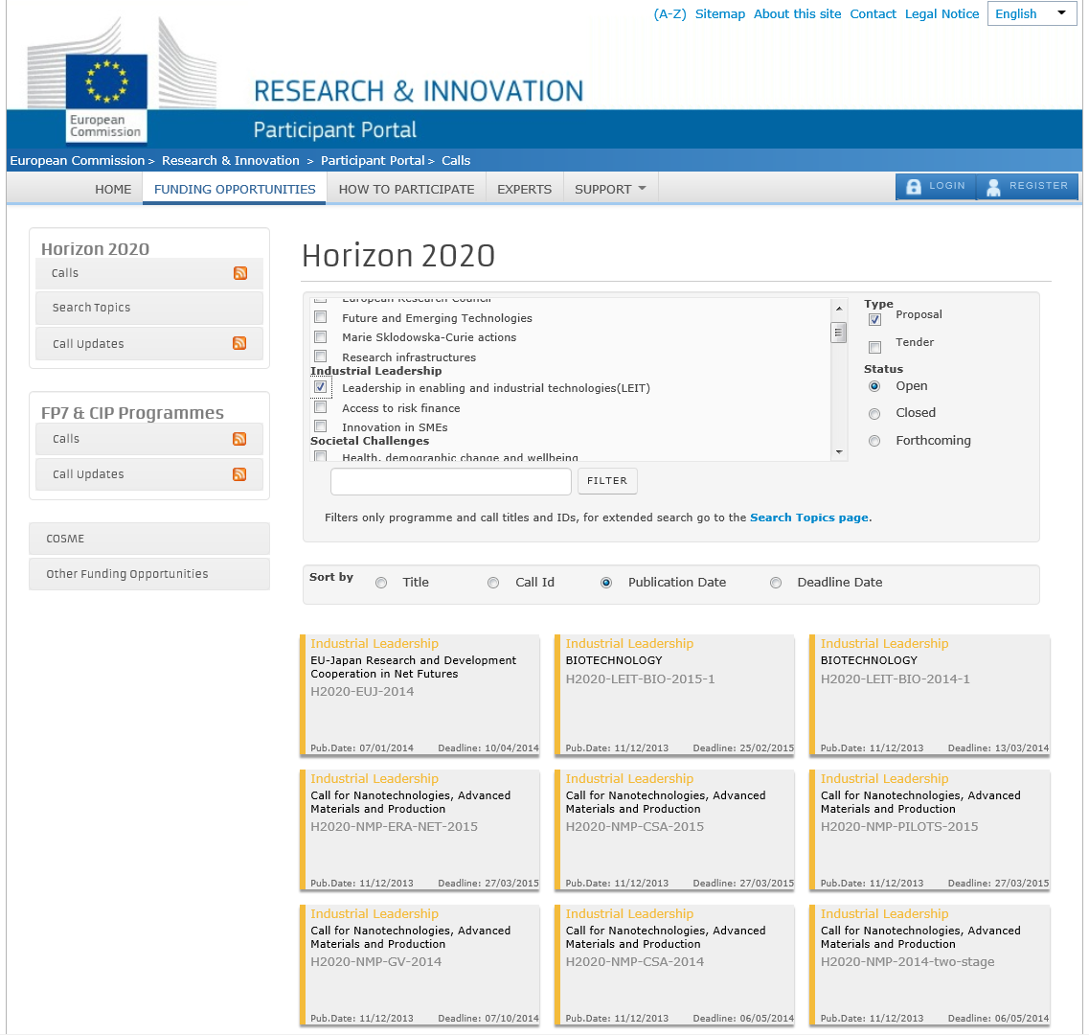
Example of a
Annual Work Programme
(LEIT)
List of Calls for proposals open

Slide 10
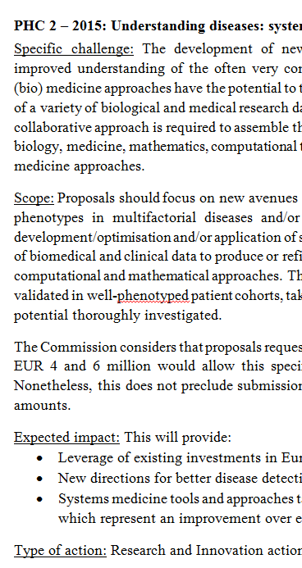
Understanding the call topics: example
'PHC 2 – 2015'
'Specific challenge'
'Scope'
'Expected impact'
'Type of action'

Slide 11
Evaluation of Proposals تقييم المقترحات
STANDARD CRITERIA المعايير
EXCELLENCE
التميز
IMPACT
الأثر
QUALITY & EFFICIENCY
الجودة والكفاءة

Slide 12
Finding partners البحث عن الشريك

Slide 13
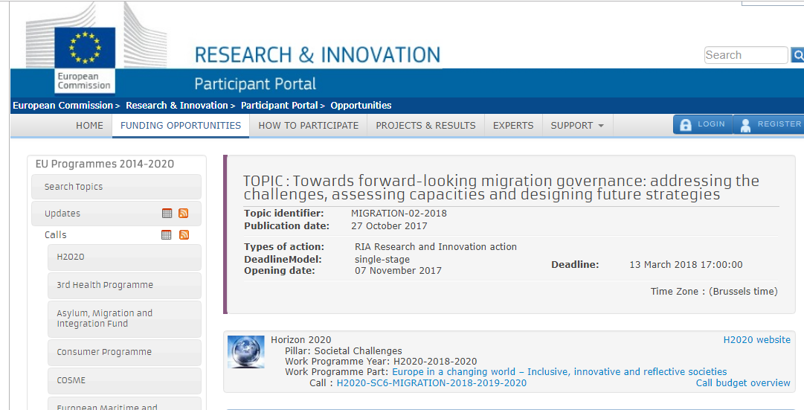
  MedMig proposal (Example) بمشاركة جامعة الزاوية H2020 مقترح مقدم لبرنامج

Slide 14


Slide 15
no. | Participant organisation name | Acronym | Country
1 | SYNYO GmbH | SYNYO | Austria
2 | UNIVERSISTY OF VIENNA | UNIVIE | AUSTRIA
3 | University of Paris 13 | UP13 | France
4 | SINUS Markt- und Sozialforschung GmbH | SINUS | Germany
5 | Fundazione Bruno Kessler | FBK | ITALY
6 | Academy of Scientific Research & Technology | ASRT | Egypt
7 | Swansea University | SWANSEA | UNIted kingdom
8 | University of Zawia | ZAWIA | LiByA
9 | Misurata University | MISURATA | LiByA
10 | The Ahmed Tlili Foundation For Democratic Culture | FATCD | Tunisia
11 | Université Moulay Ismail | UMI | Morocco
12 | universita degli studi di roma la sapienza | UNIROMA1 | Italy
13 | European Network of Living Labs | ENOLL | BELGIum
14 | FUNDACIÓN EUROÁRABE DE ALTOS ESTUDIOS | FUNDEA | SPAIN
15 | Tampere University of Applied Sciences | TAMK | Finland
16 | CENTRE DE RECHERCHE EN ÉCONOMIE APPLIQUÉE POUR LE DÉVELOPPEMENT | CREAD | Algeria

Slide 16

Contents

Slide 17
References المراجع
Horizon 2020 Online Manual
http://ec.europa.eu/research/participants/docs/h2020-funding-guide/index_en.htm
Proposal Submission Service User Manual
http://ec.europa.eu/research/participants/data/support/sep_usermanual.pdf
Guide on proposal submission and evaluation
http://ec.europa.eu/research/participants/data/ref/h2020/grants_manual/pse/h2020-guide-pse_en.pdf
Other H2020 reference documents
(rules for participation, guides for applicants, proposal templates, evaluation forms, etc)
http://ec.europa.eu/research/participants/portal/desktop/en/funding/reference_docs.html

Slide 18
شكراً لحسن استماعكم

